Slide 1

Marie McDonnell
Las Vegas
February 21, 2011
McDonnell Property Analytics

Slide 2



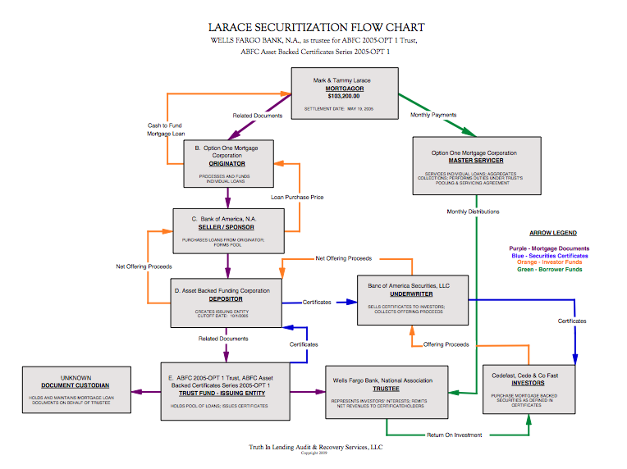



Introduction

Slide 3

U.S. BANK vs. IBANEZ

Slide 4
McDonnell’s Amicus Brief
http://tinyurl.com/69amgqb

Slide 5


Slide 6
Exhibit E
Structure of the Deal
“A” to “E” Assignments
Post-Foreclosure Assignments
Hidden Deal Flow
Fatal Break in Chain of Title

Slide 8
Exhibit F
Linda Green Assignment
14 Months Post-Foreclosure
“B” to “E” Assignment
As VP of American Home (CA)
Green Works for LPS / DOCX
Notarized In Georgia

Slide 9
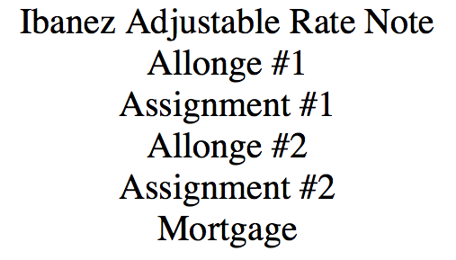

Slide 10
Exhibit H
Note Loan #00000131128
Allonge #1 – No Loan #
Assignment #1 – 12/2/05
  Handwritten Loan # 831058693
Allonge #2 – 12/1/05
  Typed Loan # 831058693

Slide 11
Exhibit H
Assignment #2 – 1/23/06
Infamous Blank Assignment
  Typed Loan # 831058693
  Typed Servicing # 0015283807
Supplemental Materials
Recorded Mortgage
  Handwritten Loan # 831058693

Slide 12


Slide 13
Exhibit I
Private Placement
Not Registered w/ SEC
Bloomberg Professional
Ibanez Loan Not In Deal

Slide 15
Exhibit J
Monthly Periodic Reports
  New Loan # 0121463913
June 2007 – Foreclosure
July 2007 – Foreclosure
August 2007 – REO
September 2007 - Liquidated

Slide 17
Exhibit K
12/2/2005 - Ibanez Buys Property
  $115,000 + $20,000 Repairs
  5/23/2008 – U.S. Bank F/C Deed
    $94,350
  12/15/2008 – Blue Spruce Entities
    $0.00
  12/15/2008 - Homesolutions
    $5,500

Slide 18


Slide 19
Exhibit L
Structure of the Deal
“A” to “D” Assignments
Ineffective Powers of Attorney
Post-Foreclosure Assignment
Fatal Break in Chain of Title

Slide 20
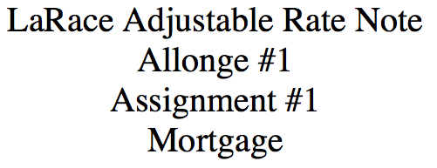

Slide 21
Exhibit M
Note Loan #231066435
Blank Assignment – 5/26/05
  Typed Loan # 231066435
  Typed Servicing # 0016768764
Allonge – 5/19/05
  Typed Loan # 231066435
  Typed Servicing # 0016768764

Slide 22


Slide 23
Exhibit N
POA From Wells to Option One
  Executed 1/5/07
Ineffective: Wrong Depositor
  Names Option One Acceptance
  Should be:
  Asset Backed Funding Corporation
See Deal # 98

Slide 25
Exhibit O
“A” to “D” Assignment
  OOMC to ABFC 2005-OPT1
Robo-signer Cindi Ellis
  Executed 5/7/2008
  “Effective Date” 4/18/2007
POA Did Not Convey Authority

Slide 26


Slide 27
Exhibit P
Public Offering
Registered With SEC
Bloomberg Professional
Loan Is Being Tracked
PSA Loan Schedule N/A

Slide 28


Slide 29



Slide 30



Slide 31
www.mcdonnellanalytics.com

