Slide 1
How to Find the Securitized Trust, The PSA, and the Note
Jay Patterson, CFE
Full Disclosure, LLC
jay@fulldisclosurellc.com

Slide 2
Important Tips:
Not every loan is securitized in a public placement deal.
Fannie/Freddie own more than half of all mortgage loans
Private Placement securitization loan info and trust documents are not available to the public.
Some loans are Portfolio owned.

Slide 3
SEARCH TOOLS
1. MERS Servicer ID
https://www.mers-servicerid.org/sis/
Fannie Mae Loan Lookup Website
http://www.fanniemae.com/loanlookup/
Freddie Mac Loan Lookup Website
https://ww3.freddiemac.com/corporate/

Slide 4
SEARCH TOOLS – Cont’d.
4. ABSNET
http://www.absnet.net/home.asp?tab=home
5. EDGARpro
http://pro.edgar-online.com/
6. EDGAR
http://www.sec.gov/edgar.shtml

Slide 5
Investor Reporting Sites
BONY Mellon:
https://gctinvestorreporting.bnymellon.com/Home.jsp
Deutsche Bank:
https://tss.sfs.db.com/investpublic/
BOA/LaSalle (they are phasing into US Bank)
https://www.etrustee.net/Default.aspx
US Bank:
https://trustinvestorreporting.usbank.com/TIR/login.jsp
Wells Fargo:
http://www.ctslink.com/
Citi:
https://sf.citidirect.com/

Slide 6
REVIEW THE LOAN DOCUMENTS
1. Origination Date
2. Loan Numbers
3. MIN Number
4. Originator
5. Endorsements, Allonges, Assignments
This will give you some clues as to the owner.

Slide 7
REVIEW MORE DOCUMENTS
1. QWR Response Letters
2. 10 day TILA Letter
3. Communications from Servicer
4. Foreclosure Documents/Affidavits
5. Proof of Claim, Notice of Appearance, Motions for Relief.

Slide 8
MERS ServicerID Website
Lookup by MIN Number
Lookup by Property Address.
Lookup by FHA, MI case number
Data is not always reliable.
https://www.mers-servicerid.org/sis/

Slide 10
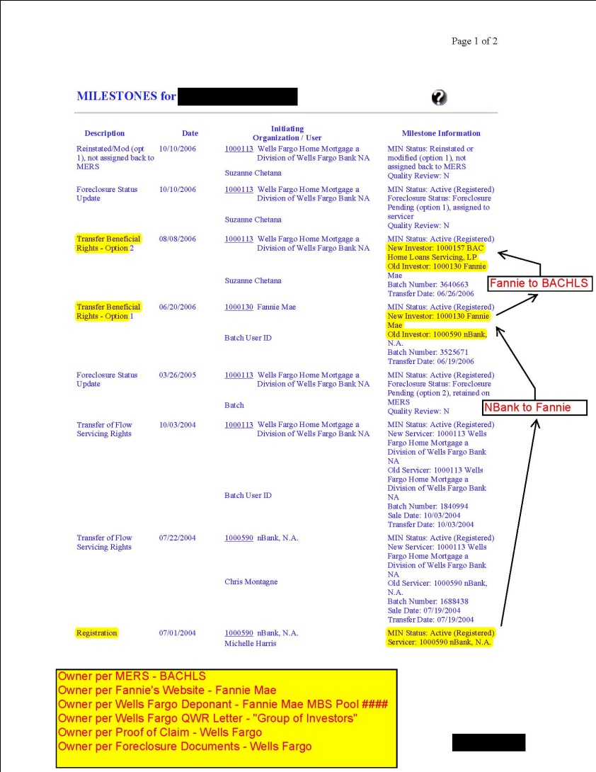
MERS Milestones

Slide 11
THIS LOAN IS ACTUALLY IN AN IXIS TRUST

Slide 14
Fannie/Freddie Lookup Tool
Fannie Site requires only Address, City,St,Zip
Freddie Site requires, Name,Address, City, St, Zip and Last four of SSN.
Fannie and Freddie owned loans are not available on a loan level basis.
Fannie and Freddie owned loans are either Securitized in one of their MBS Pools or are Portfolio Owned.

Slide 15
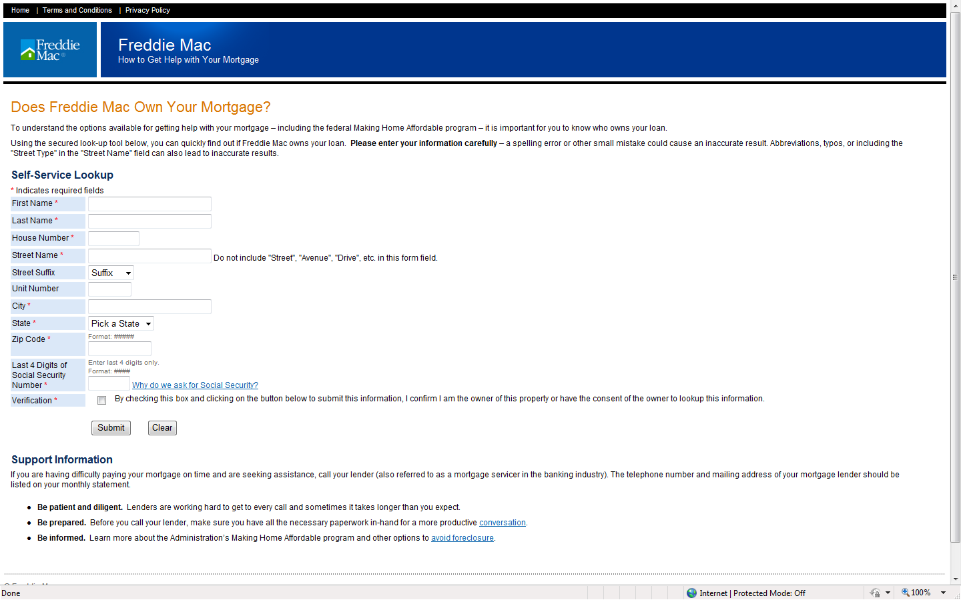
Freddie Lookup Screen

Slide 16
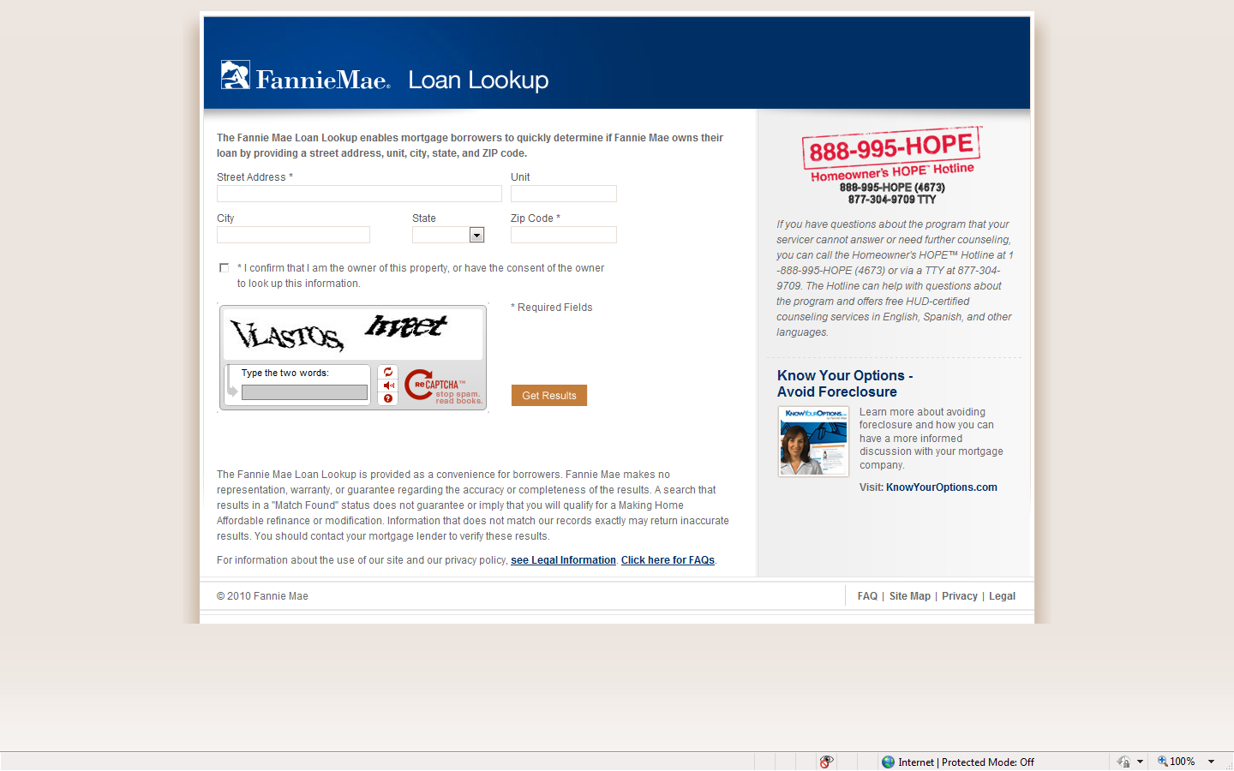
Fannie Lookup Screen

Slide 17
ABSNET
http://www.absnet.net/home.asp?tab=home
Requires Registration – Free Site
Very Informative site for Deal Search
Lookup Deals by Issuers, Trustees, Sellers, Servicers.
Deal Info also gives closing date
Deal Info gives Public or Private Placement status.
If you have the Deal name you can look here to see current trustee.
Notes:
Look up Private Deal – ACE Securities Corp – 2007-D1
Look up by Servicer, Trustee.

Slide 18
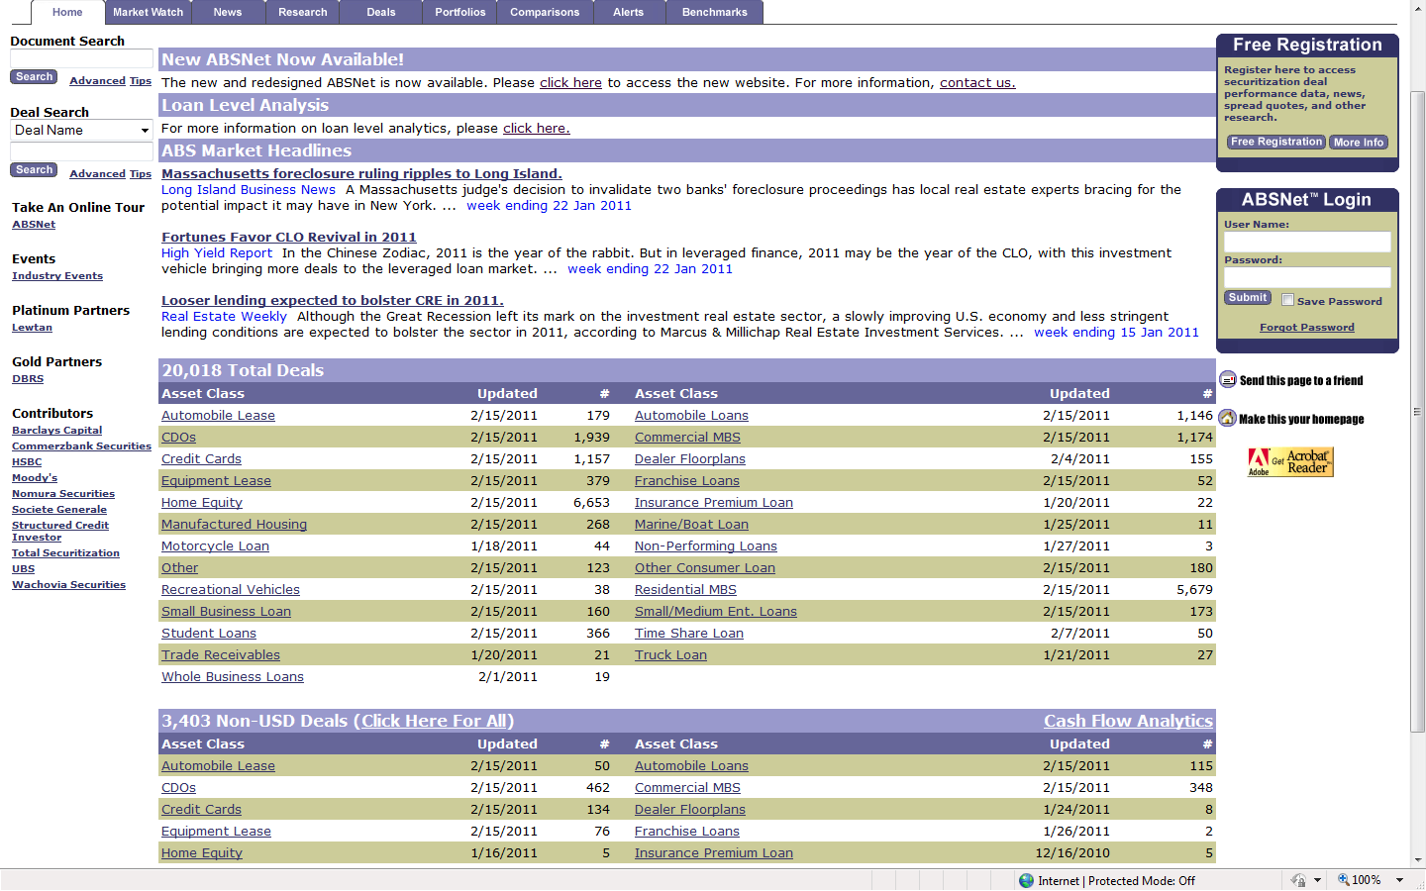
Select
Res MBS

Slide 19
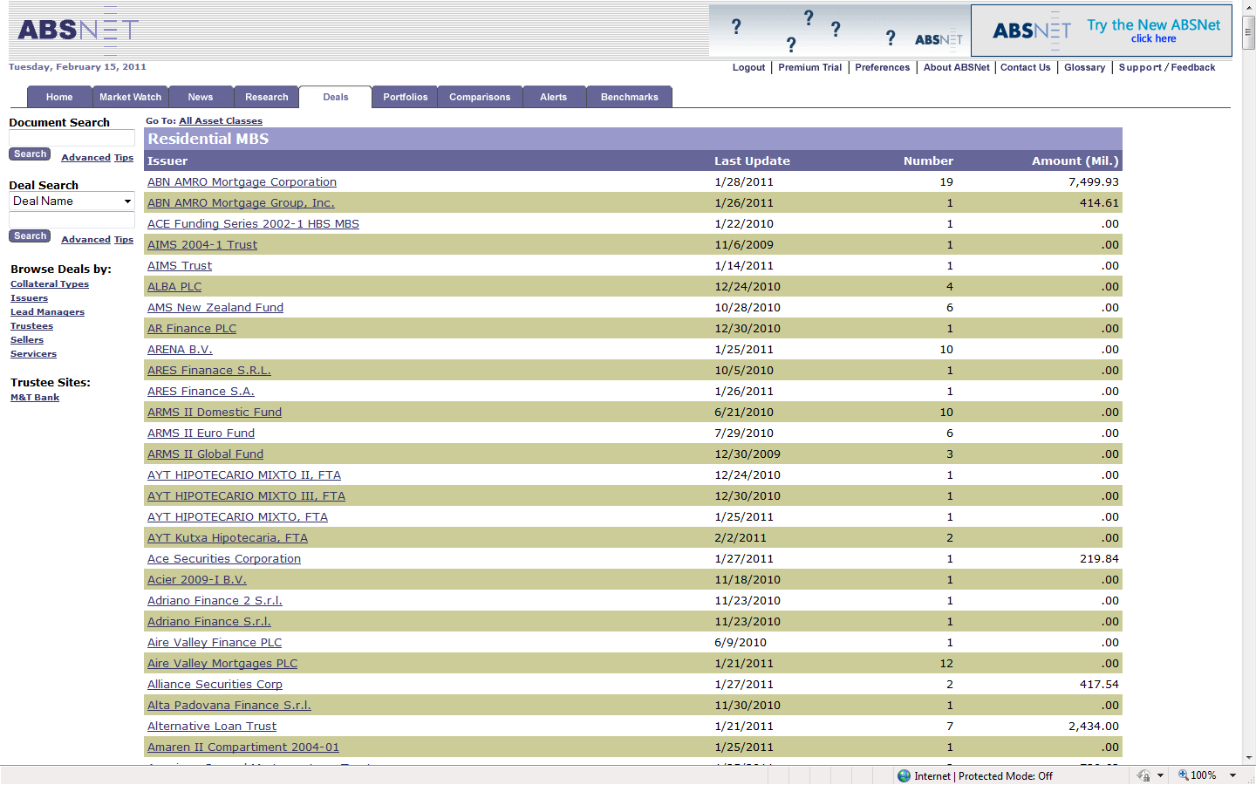
You can sort here

Slide 20
EDGARpro
http://pro.edgar-online.com/
Good Text Search site for SEC Documents.
You can search all 424b5’s (prospectuses) that have originators named to narrow down list.
You can search all 424b5’s using narrow date ranges.
You can search loan schedules on 8-K or FWP using date range with Zip Code, Loan Amt and occasionally get lucky with a loan number.

Slide 21
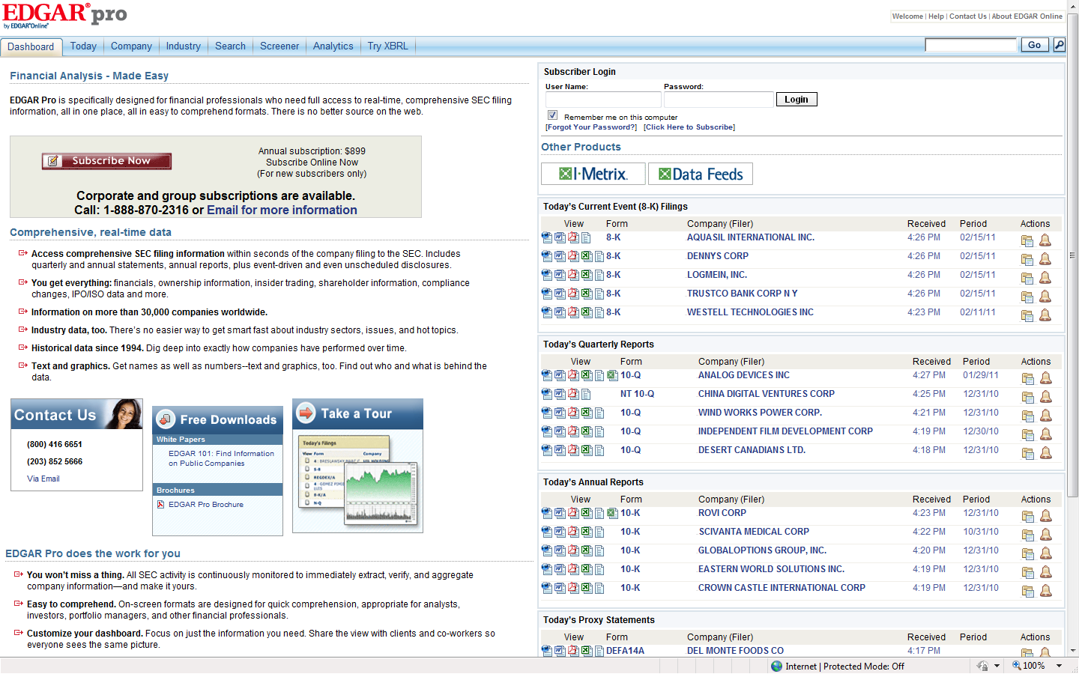

Slide 22
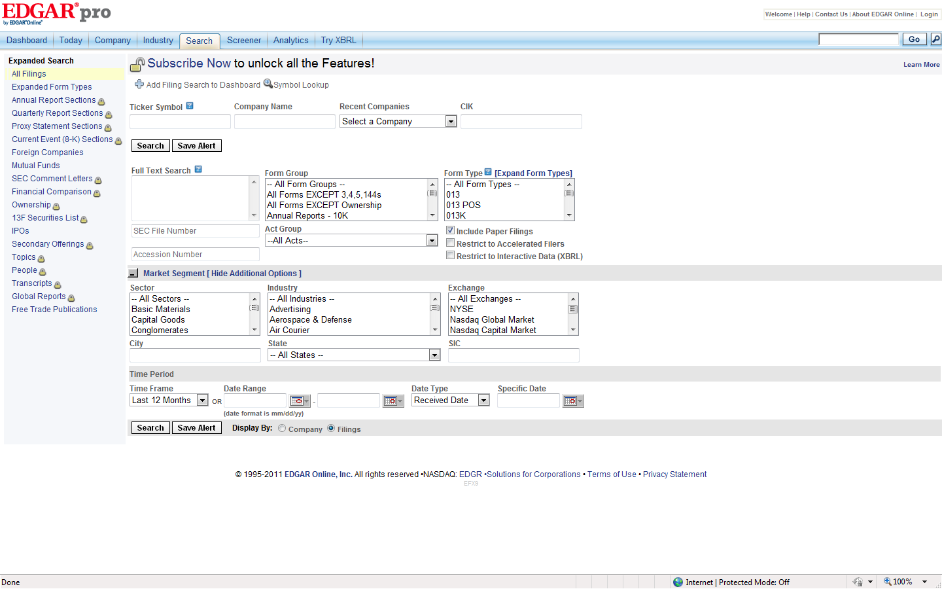

Slide 23
EDGARpro Example Searches
Loan #548949106
GMACM Mortgage Loan Trust 2003-J7
Loan Schedules filed with SEC are Few so this doesn’t work very often but it’s worth a try.
http://pro.edgar-online.com/

Slide 24
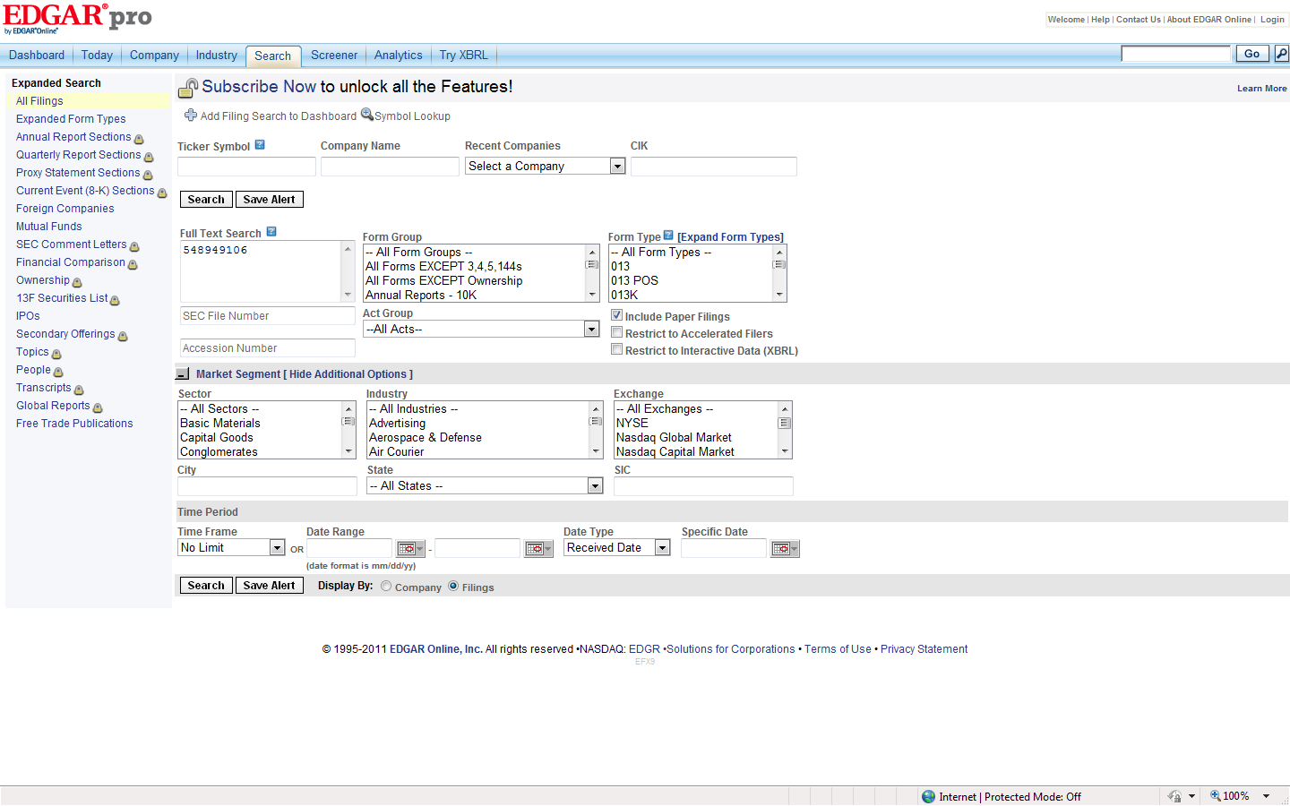

Slide 25
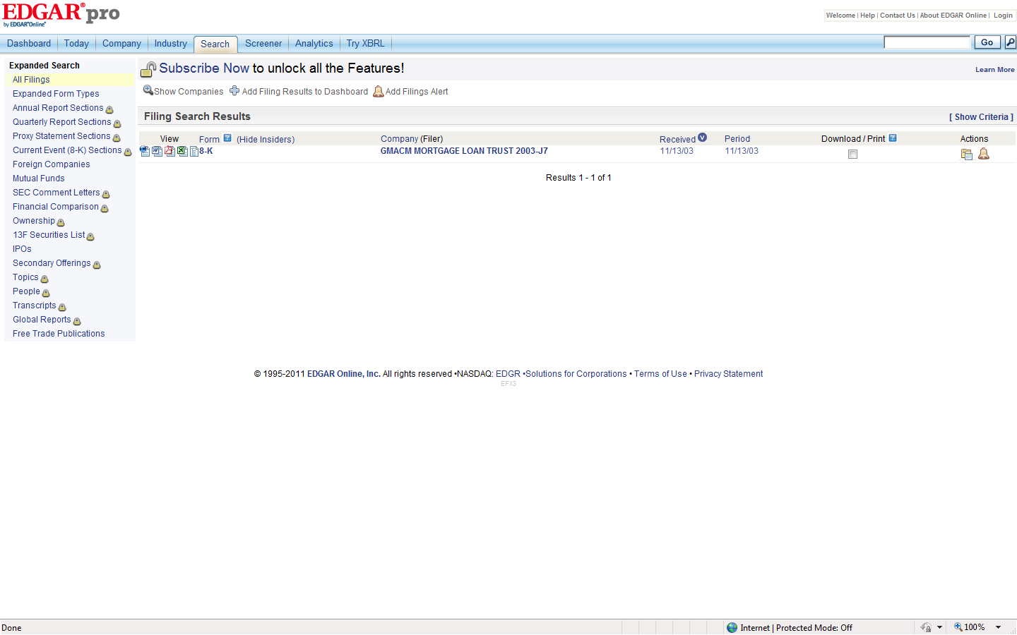

Slide 26
EDGARpro Example Searches
http://pro.edgar-online.com/
Loan Originated on 3/19/05
Originator – Plaza Home Mortgage
Loan is in Harborview MLT 2005-5Trust
Search EDGARpro using – Plaza <near/30> Originator. Date Range – 03/01/05 to 07/01/05.
15 Results. Check cut off dates
Check If there are Loan Schedules
Check Investor Sites.

Slide 27
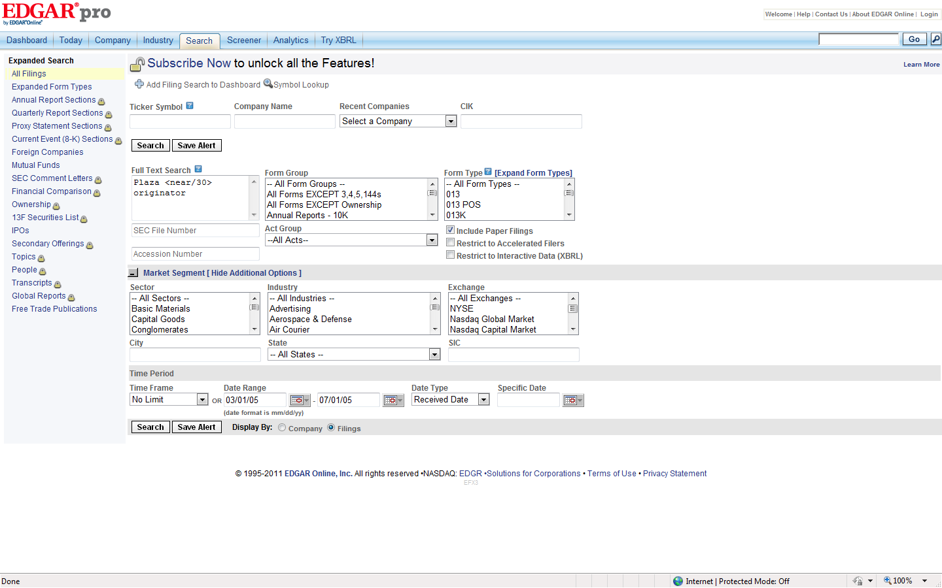

Slide 28
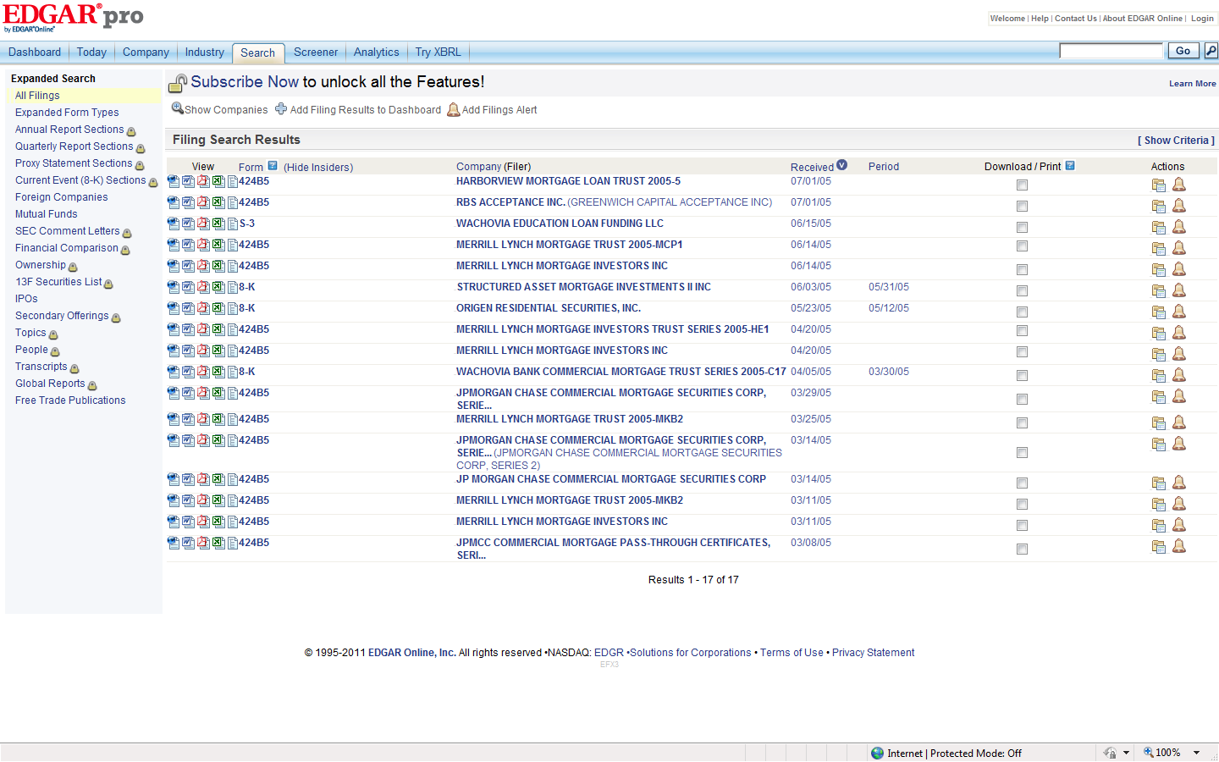

Slide 29
Investor Reporting Sites
The data contained in each deal are Remittance reports filed by the Servicers to the Trustees or Securities Administrators usually around the 25th of each month.
Remittance Reports – include detailed information for each bond class as well as performance information of the loans backing the securities.
Loan Level Reports – include each loan in the trust with detailed information as to the status of the loans. These are filed by the servicer each month. Some deals include these. Some do not.

Slide 30
Deutsche Bank Investor Reporting Example.
https://tss.sfs.db.com/investpublic/
Loan Number – 609255411
Loan Status: Foreclosure
Zip - 11554
Orig Loan Amt – 500,000
Trust – Accredited MLT 2007-1
Search Remittance Report for Loan Number
Search Loan Level Report for Loan Number

Slide 31
Subject Loan in Foreclosure Report

Slide 32
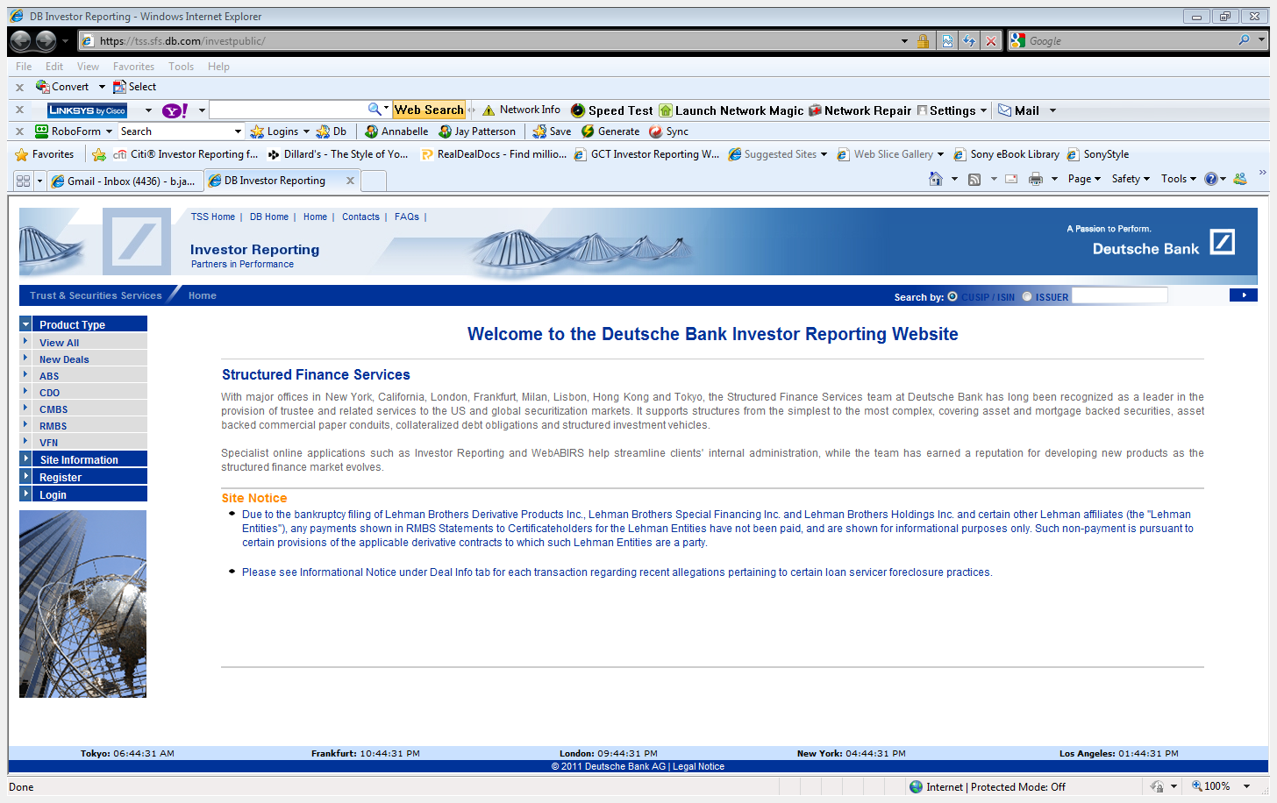

Slide 33
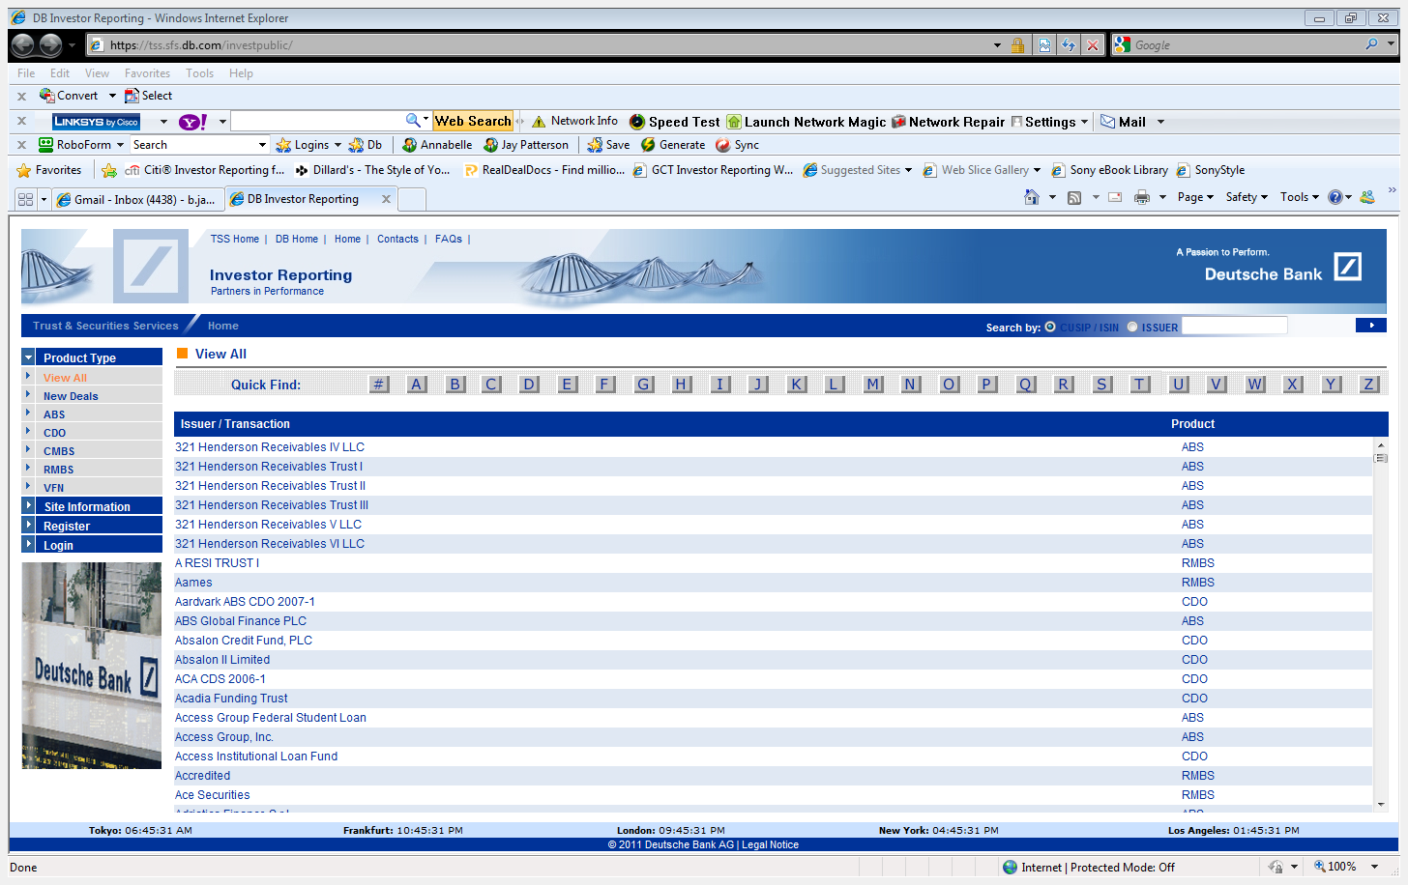

Slide 34
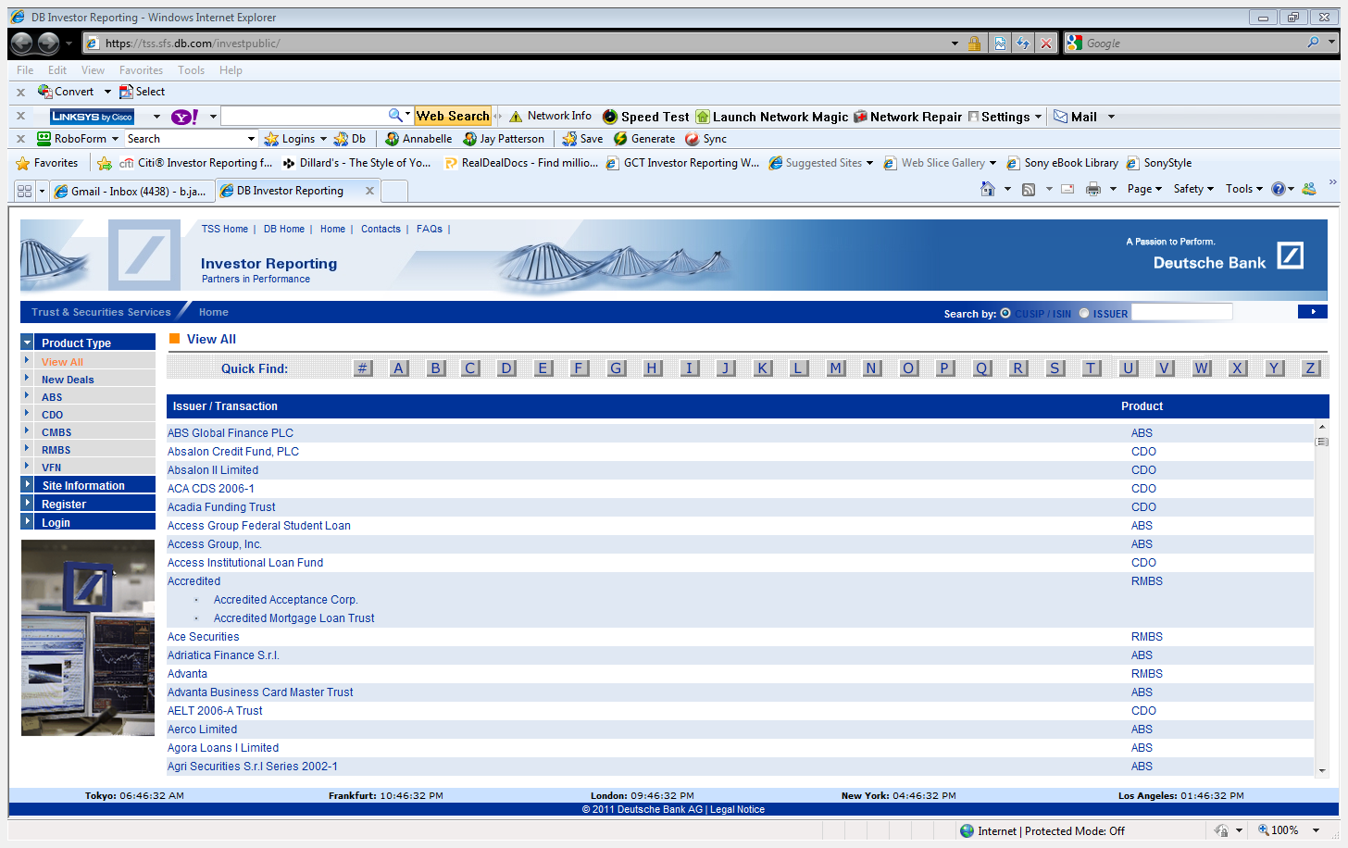

Slide 35
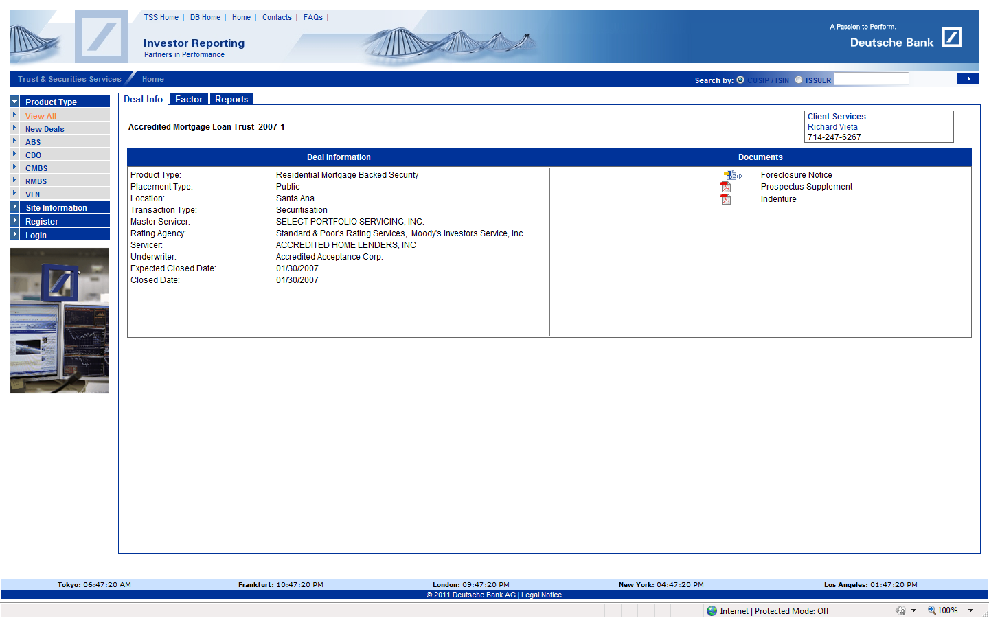

Slide 36
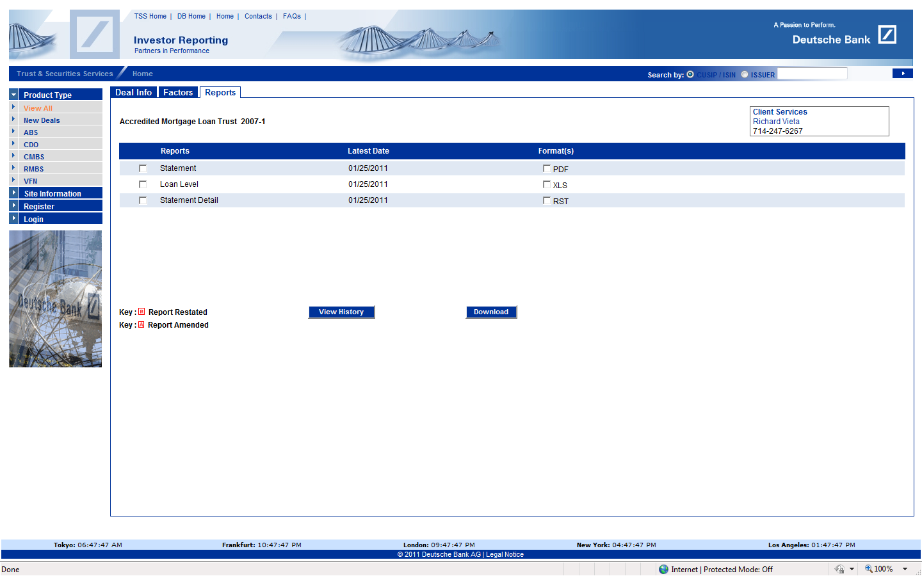

Slide 37
Remittance Report Example

Slide 38
Loan Level Remit Example

Slide 39
EDGAR
http://www.sec.gov/edgar.shtml
To find a particular Trust

Slide 40
EDGAR Tips
Conduct Search with One Word or Series Number i.e.
Harborview
2005-5
424b5 is Prospectus
8-k usually contains PSA, MLPA, AAG and Loan Schedules as exhibits.
FWP-(Free Writing Prospectus) sometimes includes Loan Schedules.

Slide 41
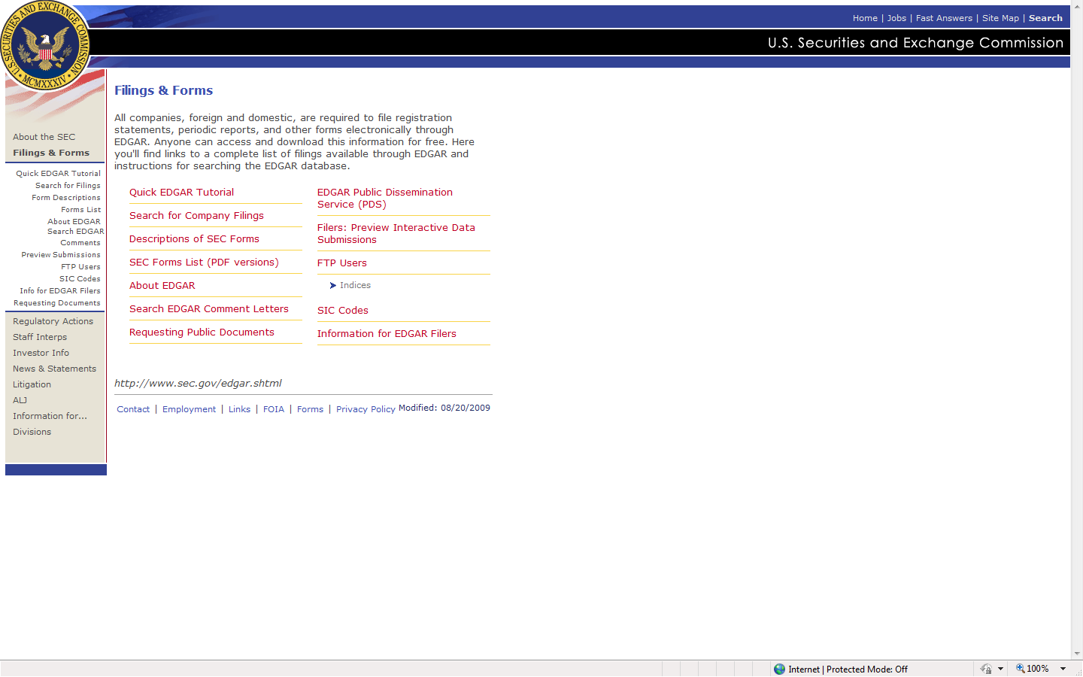
Select-Search for Company Filings

Slide 42
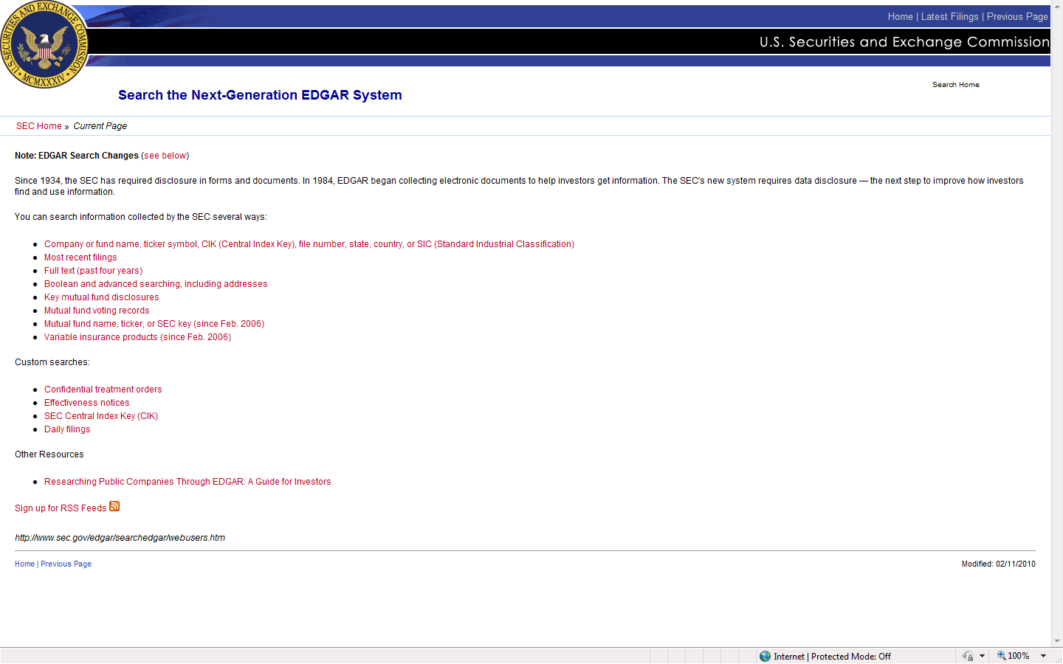
Select – Company or Fund Name

Slide 43
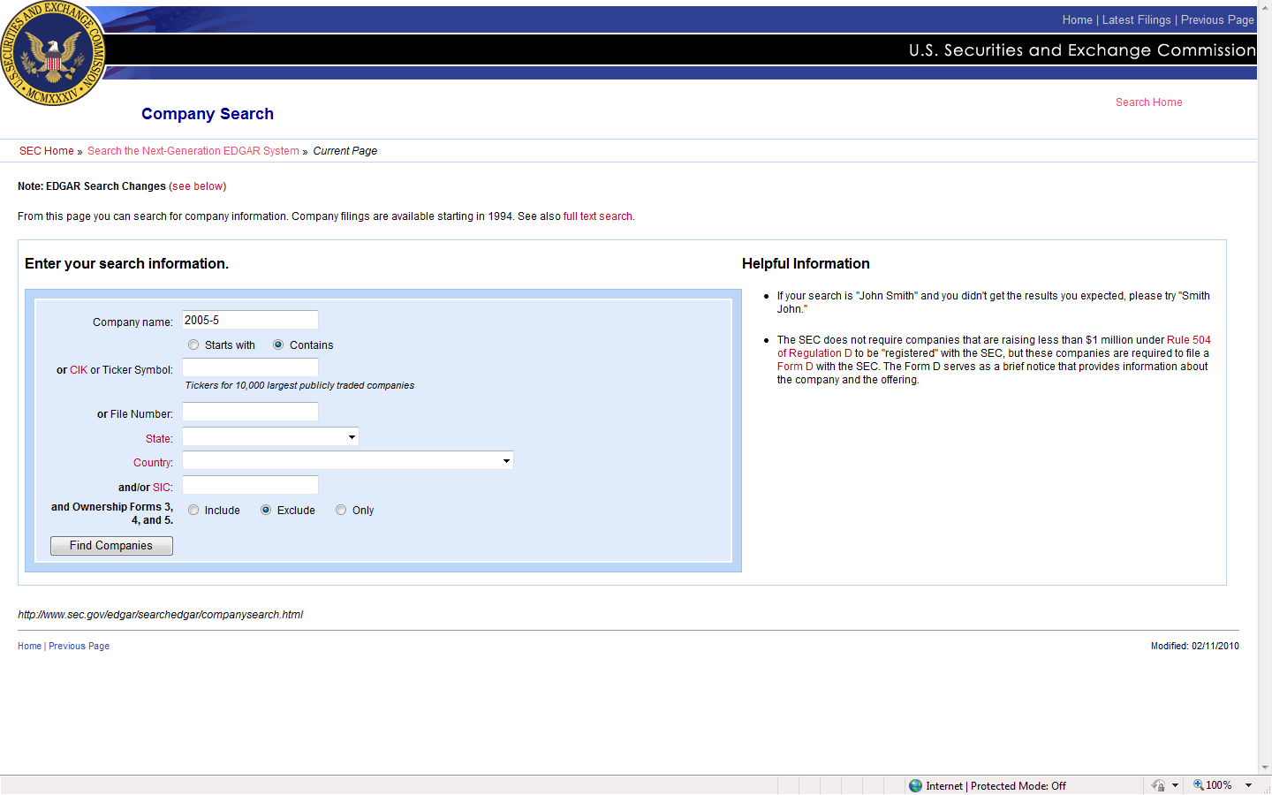
Search-Harborview 2005-5

Slide 44
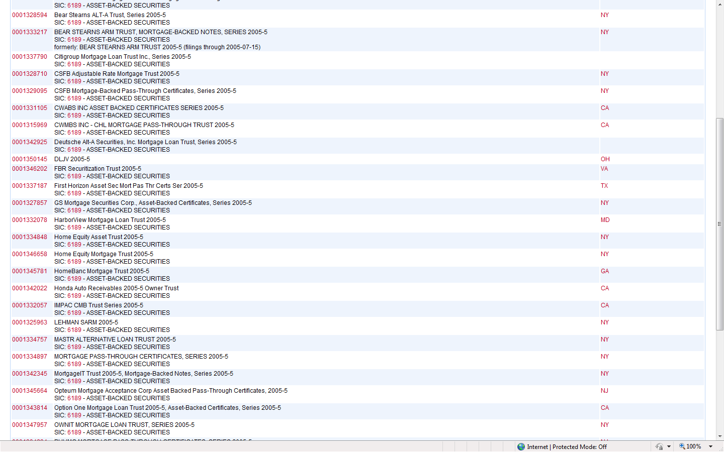
Select-Harborview 2005-5

Slide 45
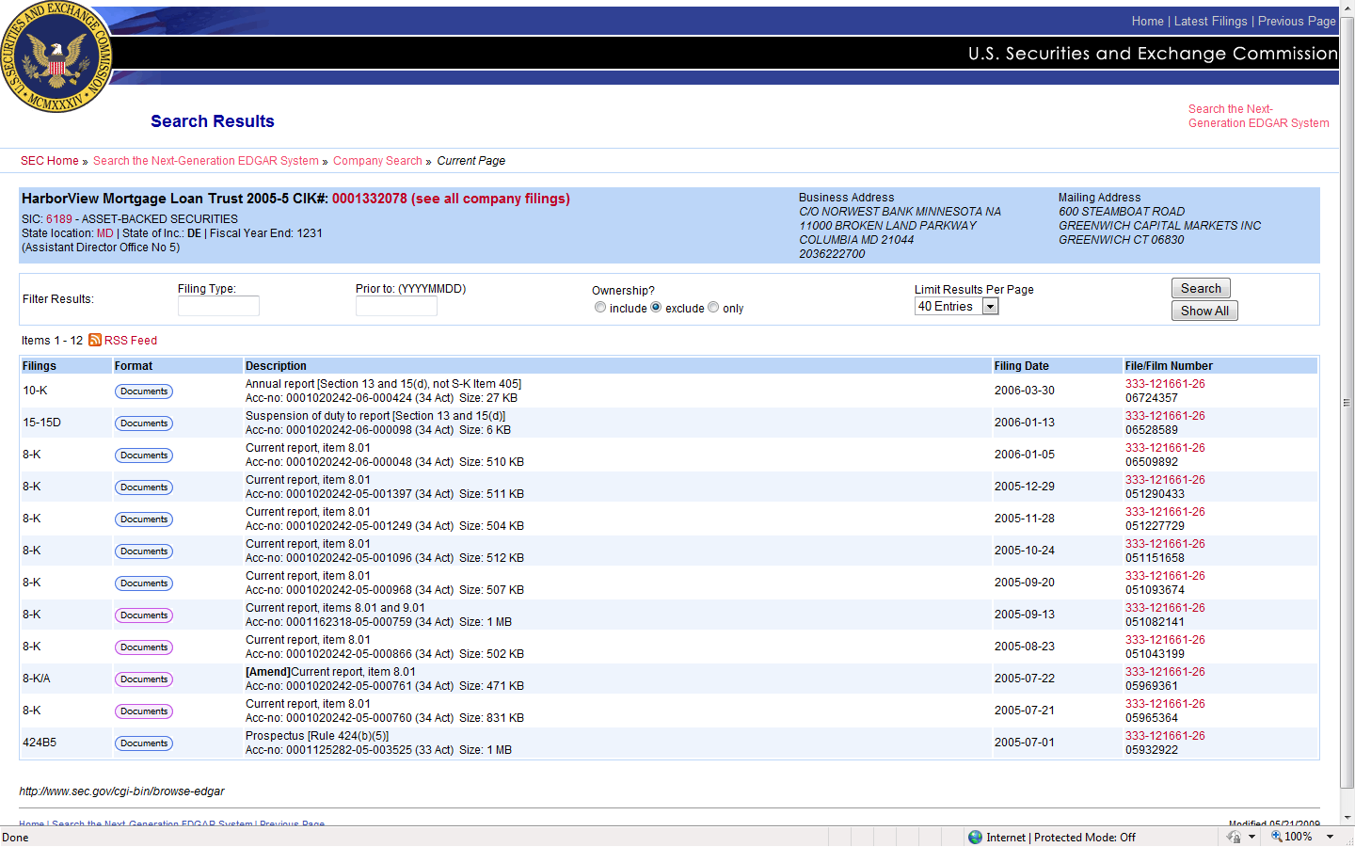
424b5-Prospectus 8-k (large file size 1mb) is PSA

Slide 46
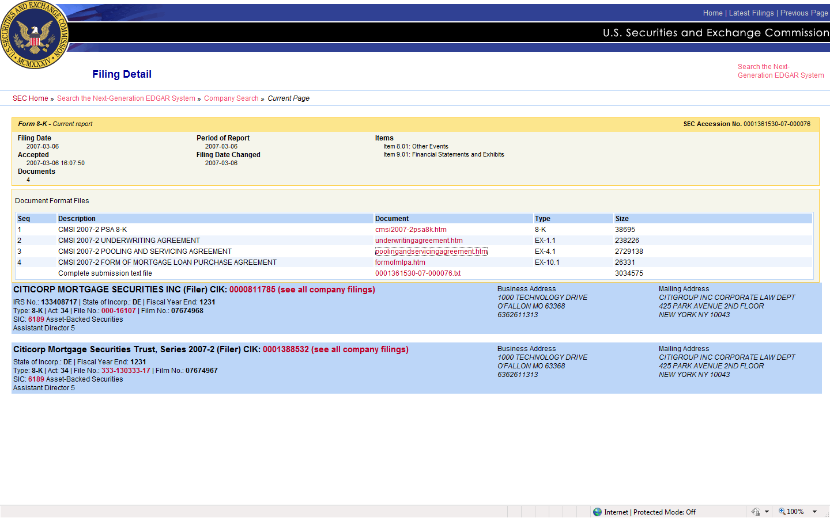
Example of PSA,UA,MLPA in EDGAR

Slide 47
THINGS TO LOOK FOR:
POC,F/C, or MFR lists Servicer as Owner
Note with No Endorsements
Note with Restricted Endorsements
Note with Blank Endorsement
Endorsements on a Blank piece of paper
Allonge with no reference to loan, property, Etc.
Note with Endorsements that fail A to D test.
AOM’s post closing date of trust
AOM’s that fail A to D test
If Trust is Named – Verify it’s a valid trust and that the loan is being reported in that trust.

Slide 48
Fannie Mae
Selling and Servicing Guides are on thumb drives or you can find at:
http://www.allregs.com/tpl/Main.aspx

Slide 49
ITEMS YOU NEED TO ANALYZE
Governing Documents
A. Pooling and Servicing Agreement (sometimes labeled “Trust Agreement”) This document is between Depositor, Trustee, Master Servicer.
B. Mortgage Loan Purchase Agreement (MLPA). This document is usually between Sponsor/Seller and Depositor.
C. Assignment and Assumption Agreement. This document is usually between Originator and Sponsor Seller.

Slide 50
Parties to the Sales
Retrieve these entities from governing documents.
A. Originator
B. Sponsor/Seller
C. Depositor
D. Issuing Entity
E. Custodian
Securities Administrator

Slide 51
Mortgage Loan Schedule
This document is filed (though not very often) with an early 8-k along with PSA.
It includes all of the mortgage loans sold into the trust.
It includes pertinent information about each mortgage loan.
This will establish that your loan was sold into the trust on closing date.

Slide 52
Remittance Reports
Filed each month by securities administrator.
Shows the payment breakdown for each class of securities.
Shows individual loan information for loans that are in Bankruptcy, Foreclosure, and REO.
Liquidated loan are shown with proceeds and realized loss.
Loan Modifications are shown.
NOT ALL REMITTANCE REPORTS CONTAIN ALL OF THIS INFORMATION.

Slide 53
LOAN LEVEL REMITTANCE REPORTS
Filed every month by the Master Servicer.
Each loan in trust is reported.
All Required reporting information is included in these reports for every loan.
Important to identify loan in early report to establish loan being reported in trust.
Important to identify loan in latest report to establish loan currently being reported in trust.
NOT EVERY TRUST PUBLISHES LOAN LEVEL REMITTANCE REPORTS.

Slide 54
Remittance Reports
A Compilation of these reports will establish the loan was being reported as an asset of the trust from the closing date through present date.

Slide 55
WAMU TRUSTS
Most of their remittance reports do not contain loan information or loan modification information.
None of their trusts include loan level remittance reports.

Slide 56
Analysis
Establish Flow of Sales from Originator to Trust per the Deal Documents
Establish that loan was being reported as an asset of trust on closing date through current date through remittance reports.
Establish actual flow of loan per Actual Documents.

Slide 57
Case Study #1
Court Documents list Servicer as Creditor
Loan is in a Trust

Slide 58
Case Study #2
Court Documents state loan is in MASTR Trust
Loan has actually been in TWO Trusts.

