Slide 1


New Federal Rules 3001 and 3002.1

Slide 2
New Federal Rules 3001 and 3002.1
The U.S. Supreme Court adopted the amendments to the Federal Rules of Bankruptcy Procedure and submitted the rules to Congress for final review and approval. The new rules became effective December 1, 2011, again changing procedure and policy for servicing loans in bankruptcy.
The relevant changes are to Rule 3001 governing the filing of proofs of claim (POC), and new rule 3002.1, which covers notice issues relating to payment changes, post-petition fees, expenses and charges, and a new procedure implemented to determine loan status at discharge.

Slide 3
Changes to Rules and Forms
12/1/2011
Rule 3001 – Proof of Claim (amended)
Rule 3002.1 – Notice Relating to Claims Secured by Security Interest In Debtor’s Principal Residence (new)
Form B 10 (Attachment A) – Mortgage Proof of Claim Attachment (new)
Form B 10 (Supplement 1) – Notice of Mortgage Payment Change (new)
Form B 10 (Supplement 2) – Notice of Post petition Mortgage Fees, Expenses, and Charges (new)

Slide 4
Changes to Rule 3001
Rule 3001 has been amended to add additional requirements in an individual debtor case and provides sanctions for failure to comply with the new provisions.
  New requirements include:
    If POC includes pre petition interest, fees or other charges, they have to be itemized.
    If a security interest is claimed, the amount to cure has to be listed in the POC.
    New Attachment B 10 has to be completed and filed with the POC.
    If an escrowed loan, a RESPA analysis prepared as of the date of filing must be submitted with the POC.

Slide 5
Sanctions under Rule 3001
If the creditor fails to provide the required form and information, the Court after notice and hearing can take either or both of the following actions:
  Preclude the creditor from presenting the omitted information, in any form, as evidence in any contested matter or adversary proceeding, unless the court determines that the failure was substantially justified or harmless.
  Award other relief including reasonable expenses and attorneys fees caused by the failure.

Slide 6
Rule 3001 – Comments
  Statement must include sufficient specificity to make clear the basis for the claimed amount.
  RESPA form filed with Court can be in the same form that is used outside of bankruptcy.
  Failure to provide the information on the claim is not reason for disallowance of the claim but if an objection is filed or other litigation arises concerning the status of treatment of the claim, the court may preclude it from presenting the omitted information.

Slide 7
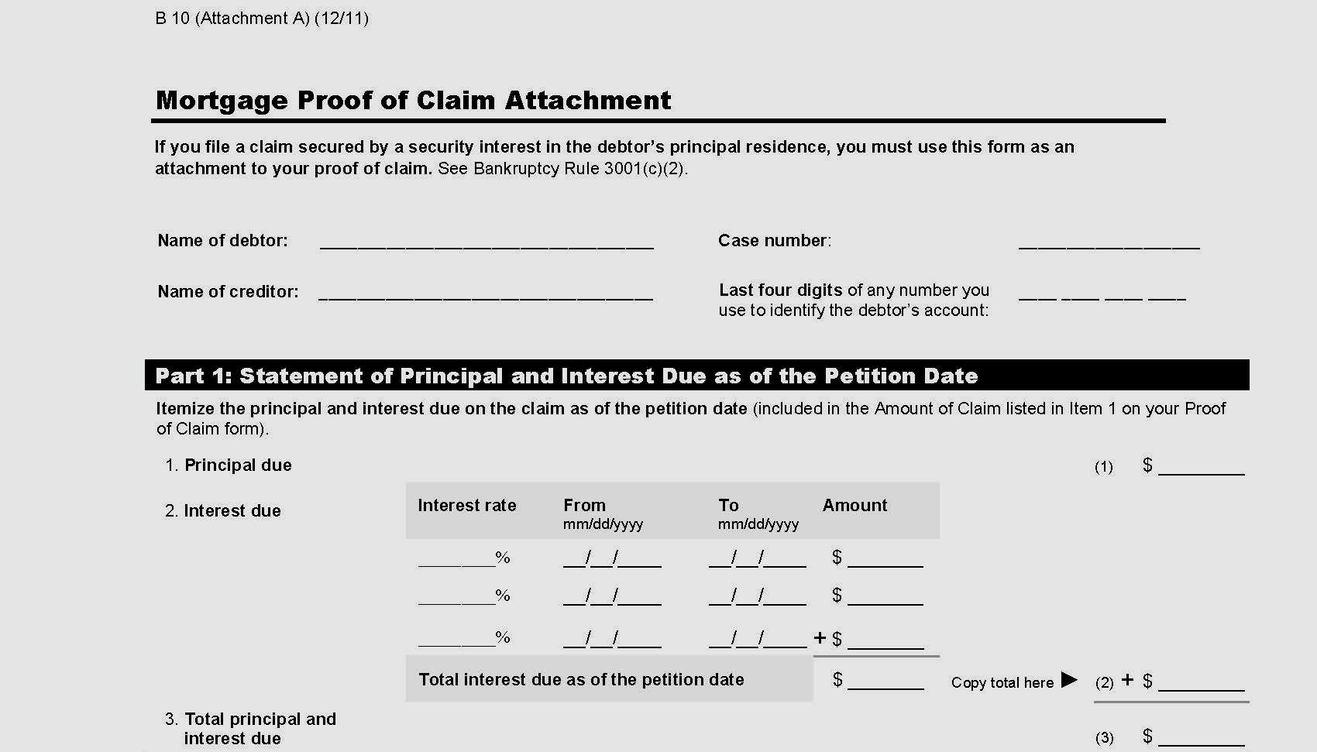
Form B 10 (Attachment A)

Slide 8
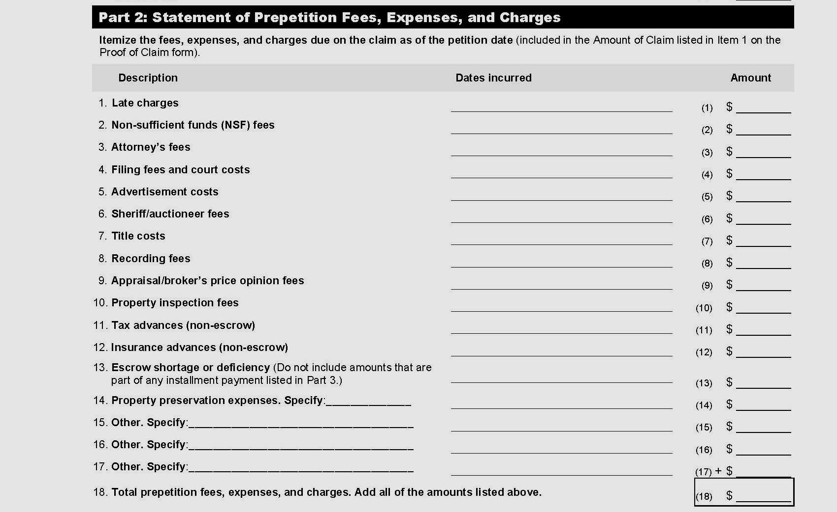

Slide 9
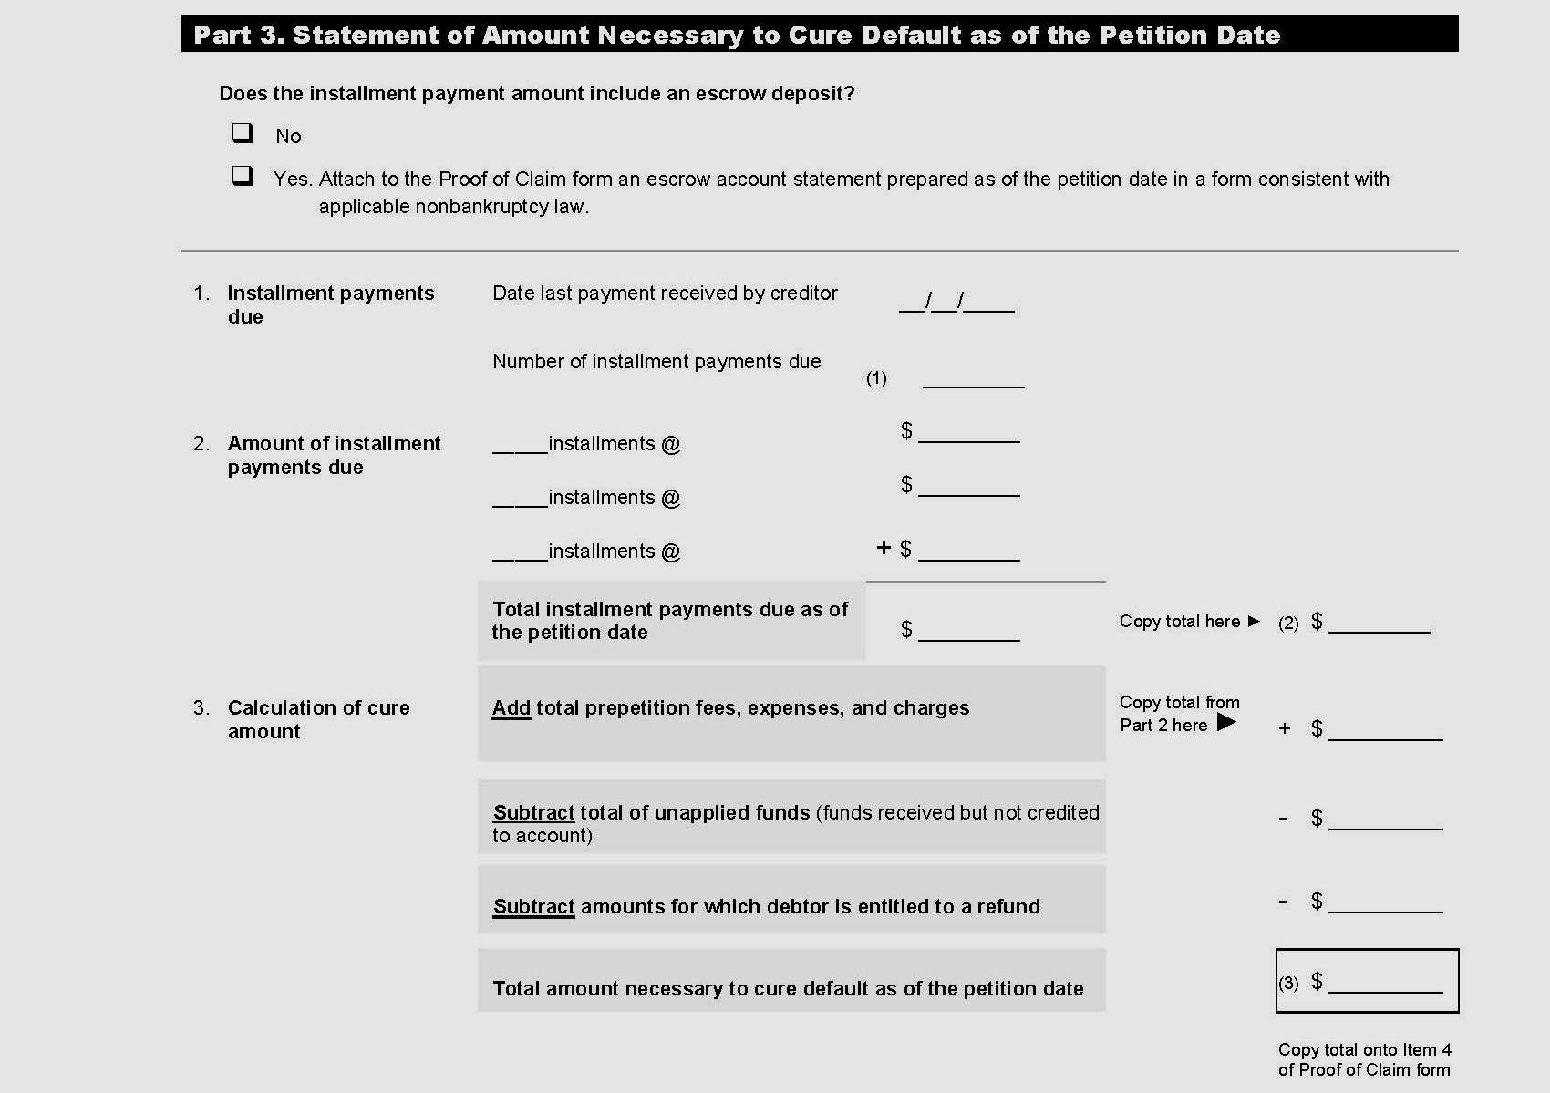

Slide 10
Rule 3002.1
Notice of Payment Changes
Supplements § 1322(b)(5). In a Chapter 13, in a claim secured by an interest in the debtor’s principal residence and provided for by the debtor’s plan, the holder of claim is required to:
  file with Court and serve on the trustee, debtor and debtor’s counsel, any payment change due to interest rate or escrow change 30 days before the effective date of the change;
  use Form B 10 (Supplement 1) with attachment that is the form of notice required under applicable non bankruptcy law; and
  file with Court as a supplement to the POC.

Slide 11
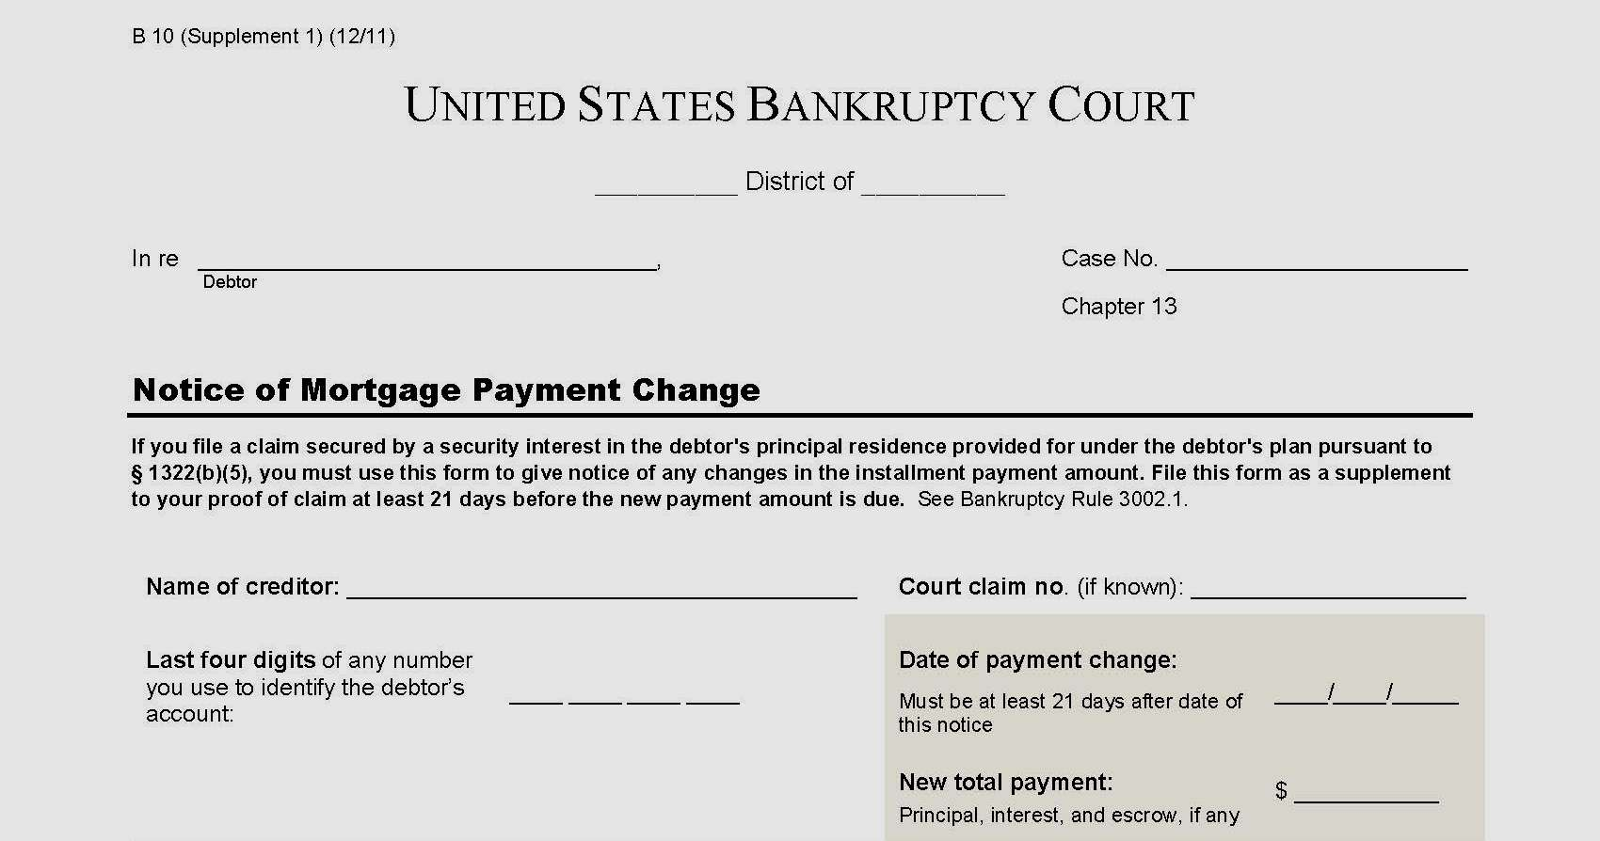
Form B 10 (Supplement 1)

Slide 12
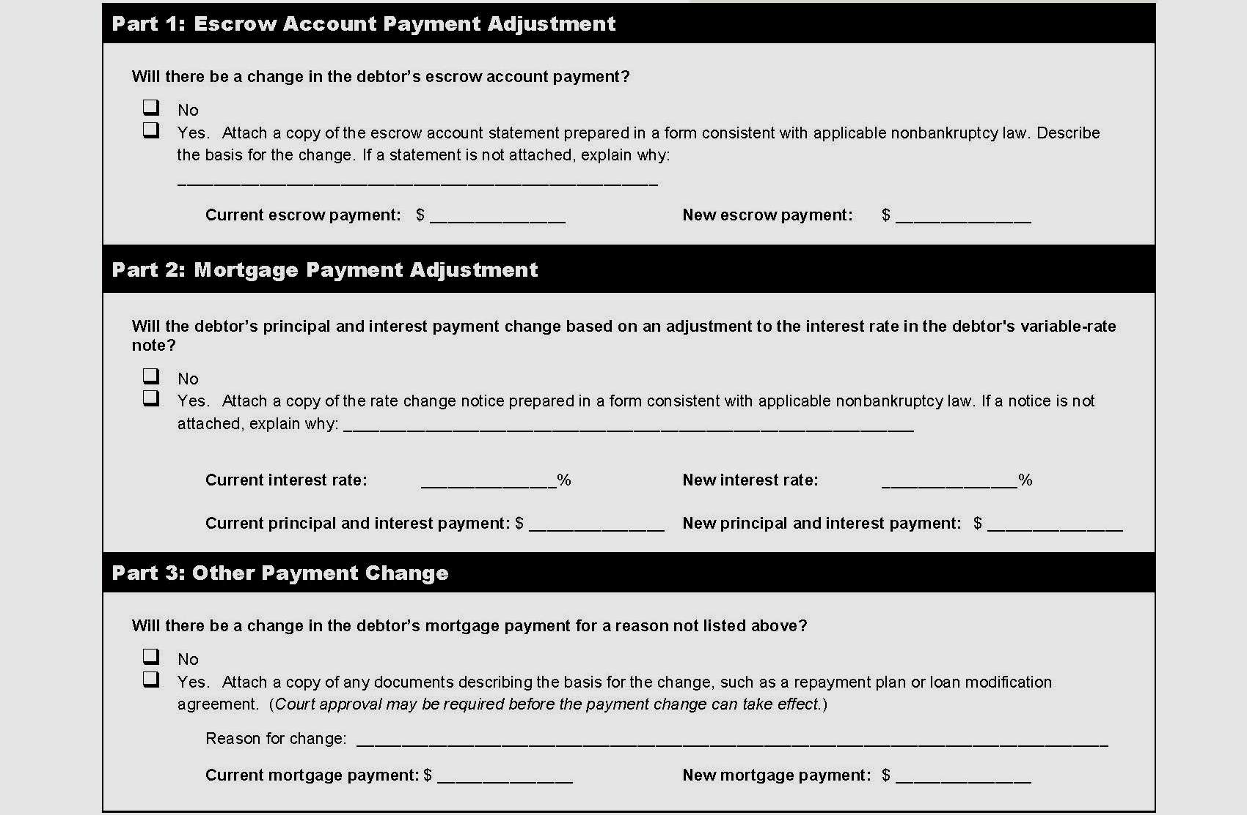

Slide 13
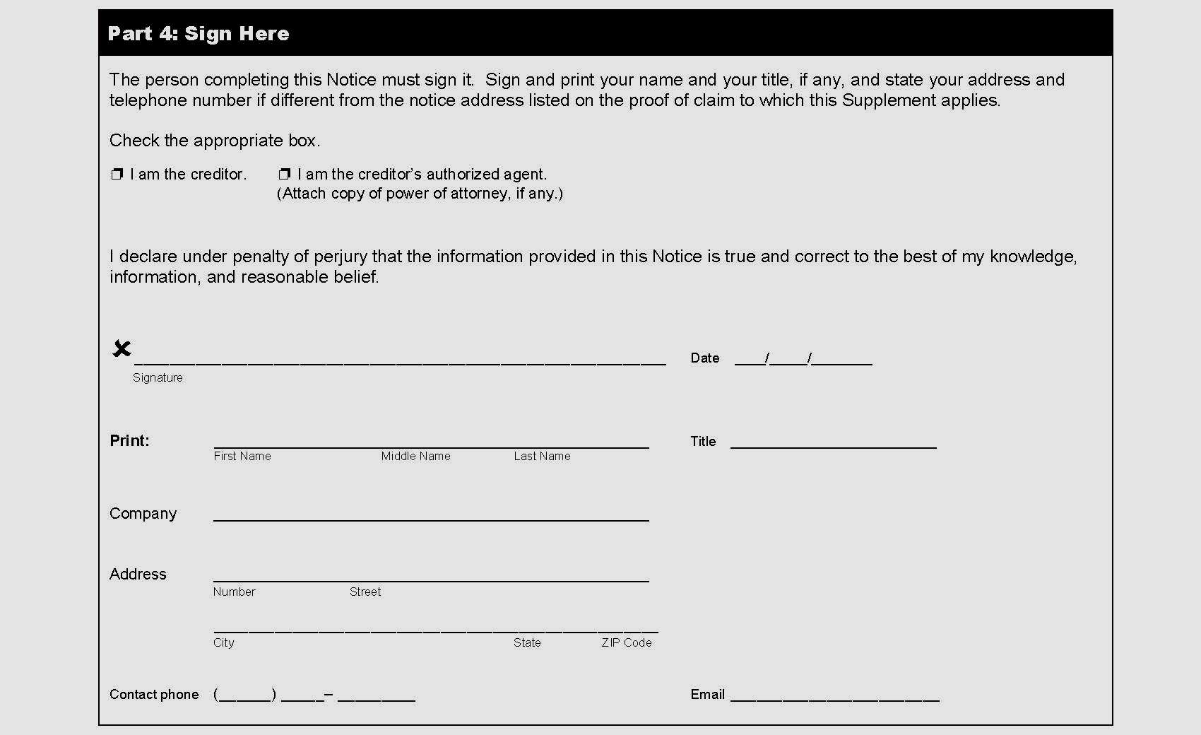

Slide 14
Rule 3002.1
Notice of Fees, Expenses & Charges
In a Chapter 13, in a claim secured by an interest in the debtor’s principal residence and provided for by the debtor’s plan, the holder of claim is required to:
  file with Court and serve on the trustee, debtor and debtor’s counsel, a notice that itemizes all post petition fees, expenses, or charges incurred in connection with the claim that the holder asserts are recoverable against the debtor or his principal residence;
  notice is filed as a supplement to the POC and served no later than 180 days after the date when the fees, expenses or charges are incurred; and
  can be filed by creditor or creditor’s agent (must include POA).

Slide 15
Rule 3002.1(c)- Comments
Per the committee, this notice includes inspection fees, late fees, attorney’s fees.
It would also include property preservation fees, non escrowed taxes paid and forced placed insurance.
Filing and service requirement for the notice are the same as for the notice required under subsection (a).

Slide 16
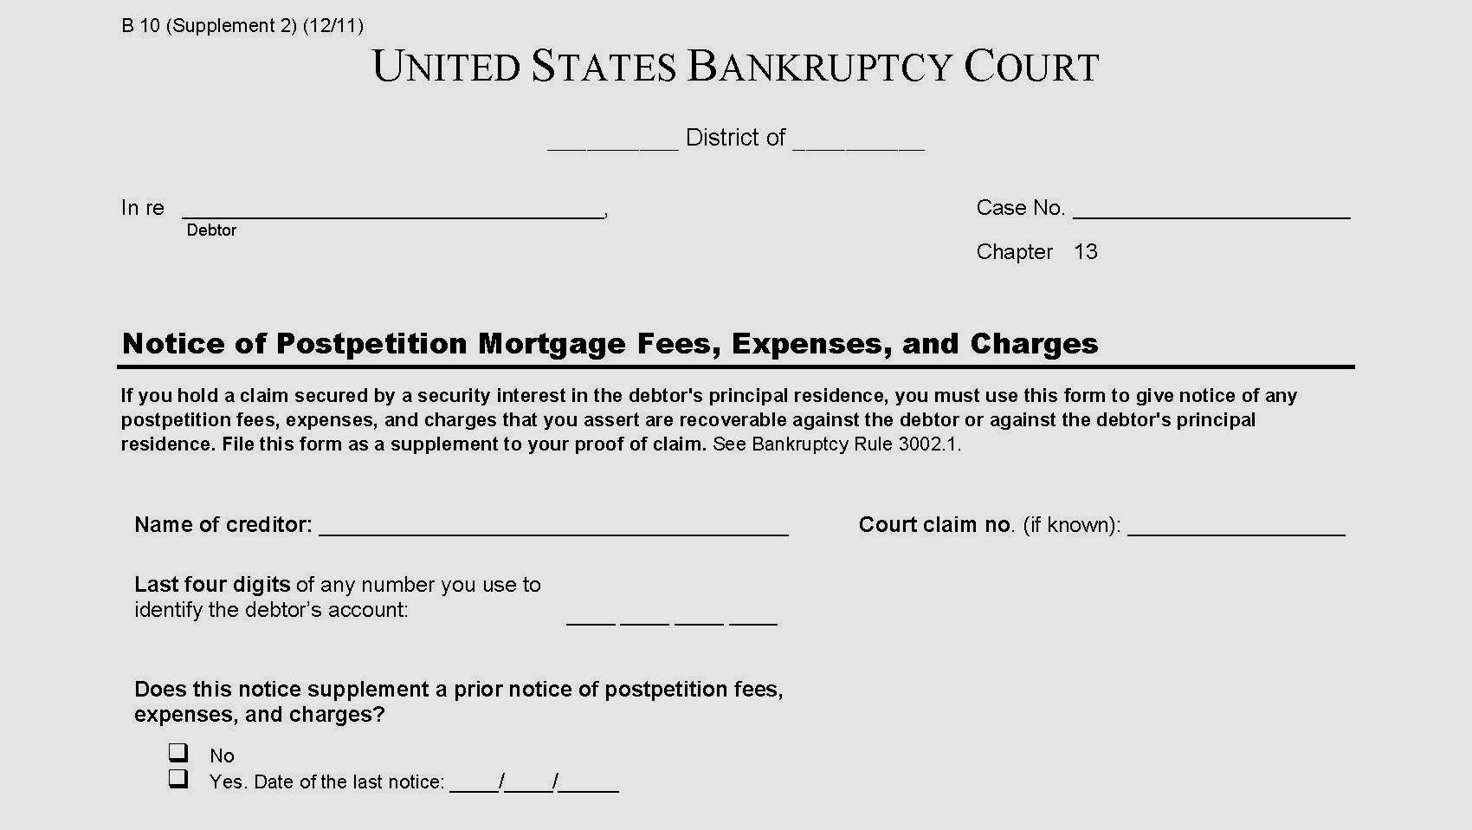
Form B 10 (Supplement 2)

Slide 17
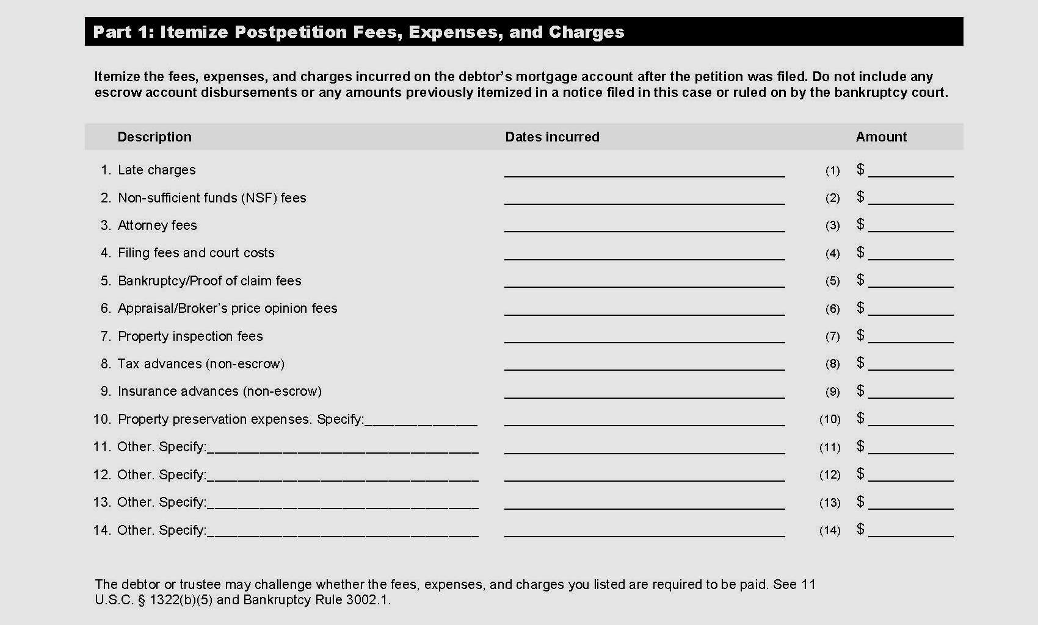

Slide 18
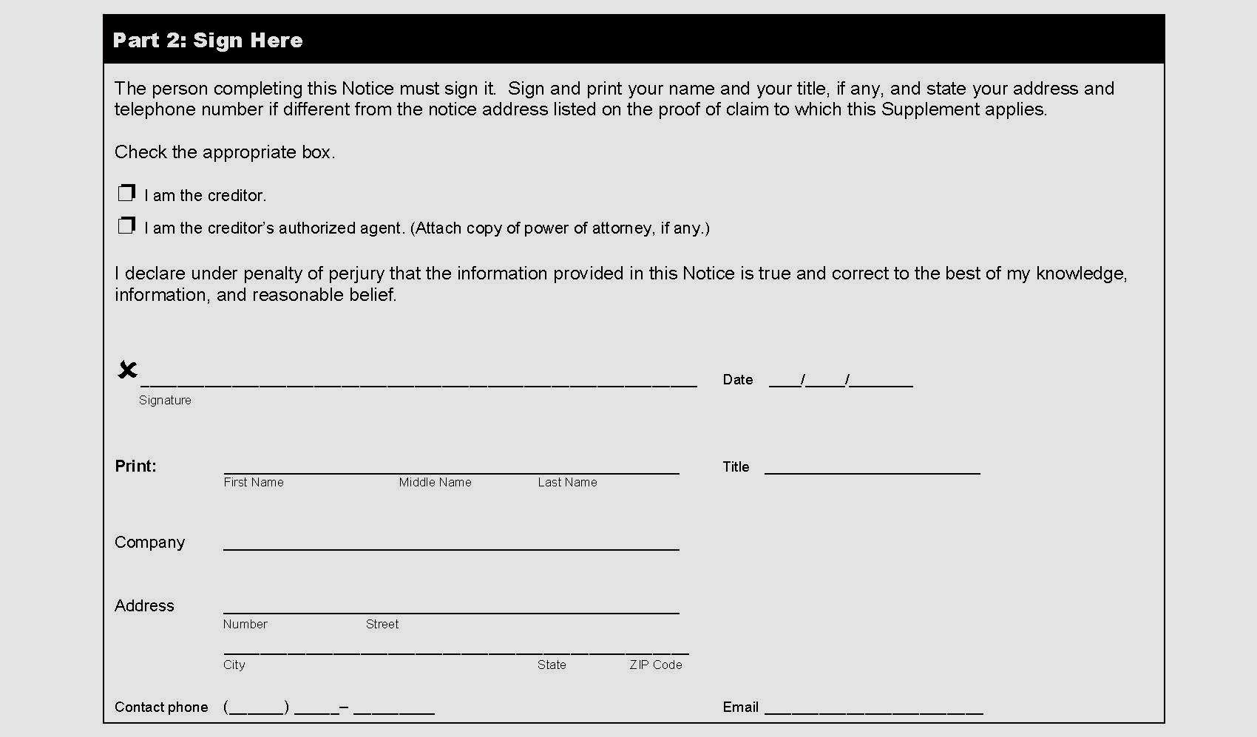

Slide 19
Debtor or Trustee Can Ask Court to Review the Fee, Charge or Expense
On motion by debtor or trustee, filed no later than one year after the service of the notice, the court shall hold a hearing to determine whether payment of the fee, expense or charge is required by the underlying agreement and applicable non bankruptcy law.

Slide 20
Rule 3002.1(d)
Notice of Final Cure Payment
No later than 30 days after making final payment of any cure amount on a claim secured by a security interest in the debtor’s principal residence, the Trustee shall file and serve upon the holder of the claim, debtor and debtor’s counsel a notice stating that the amount to cure the default has been paid in full.
Can also be filed by the debtor’s attorney.

Slide 21
Sample Notice of Final Cure Payment Form
Notice of Final Cure Payment
Pursuant to Fed. Bankr. Rule 3002.1(d), the Trustee files Notice that the amount required to cure the default in the below claim has been paid in full.
Name of creditor: _______________________________ Court claim no. (if known): _____________
Last four digits of any number used to identify the debtor’s account: ____ ____ ____ ____
Amount of Prepetition Arrears $________________
Amount Paid by Trustee $________________
Mortgage is paid:
☐ Thru the Chapter 13 conduit ☐ Direct by the Debtor(s)
Within 21 days of the service of this Notice, the creditor must file and serve same on the debtor, debtor’s counsel and the trustee, pursuant to Fed. Bankr. Rule 3002.1(e), a statement indicating whether it agrees that the debtor has paid in full the amount required to cure the default and whether, consistent with §1322(b)(5), the debtor is otherwise current on all payments or be subject to further action of the court including possible sanctions.

Slide 22
Rule 3002.1(e) Response to Notice of Final Cure Payment
No later than 21 days after the service of the notice in 3002.1(d), the holder of the claim SHALL file and serve on the debtor, debtor’s attorney and trustee indicating:
  whether it agrees the debtor has paid in full the amount required to cure the default; and
  whether the Debtor is otherwise current on all payments.

Slide 23
Statement under 3002.1(e)
Statement shall itemize:
  Any required cure amount and/or
  Post petition amounts that the holder contends remain unpaid as of the date of the statement.
Statement is filed as supplement to the holder’s proof of claim.
Per commentary, the response must itemize all missed amounts that the holder contends are still due.

Slide 24
Rule 3002.1(f)
Response to Creditor’s Statement
On motion of the debtor or trustee filed no later than 21 days after service of the statement under subdivision (e) of this rule, the court shall, after notice and hearing, determine whether the debtor has cured the default and paid all required post-petition amounts in full.

Slide 25
Rule 3002.1(g)
Preclusion & Sanctions for Failure to Notify
If the holder fails to provide any information required by subdivision (a), (c), or (e) of this rule, the holder shall be precluded from presenting the omitted information, in any form, as evidence in any hearing or submission in any contested matter or adversary proceeding in the case, unless the court determines that the failure was substantially justified or is harmless.
In addition to or in lieu of this sanction, the court may, after notice and hearing, award other appropriate relief, including reasonable expenses and attorney’s fees caused by the failure.

Slide 26
Commentary
If, after the chapter 13 debtor has completed payments under the plan and the case has been closed, the holder of a claim secured by the debtor’s principal residence seeks to recover amounts that should have been but were not disclosed under this rule, the debtor may move to have the case reopened in order to seek sanctions against the holder of the claim under subdivision (g).

Slide 27
Rule 3002.1 Comments
In order to fulfill the obligations of 1322(b)(5), the debtor and trustee must be informed of the exact amount needed to cure any pre petition arrearage and the amount of the post petition payment obligations.
Timely notice of the changes will permit the debtor or trustee to challenge the validity of the charges and adjust the payment for any properly claimed adjustment.

Slide 28
MAX GARDNER’S BANKRUPTCY BOOT CAMPS
PO Box 177
Casar, NC 28020
704.418.2628 (Max Direct)
www.maxbankruptcybootcamp.com
www.maxgardner.com
maxgardner@maxgardner.com

